Slide 1
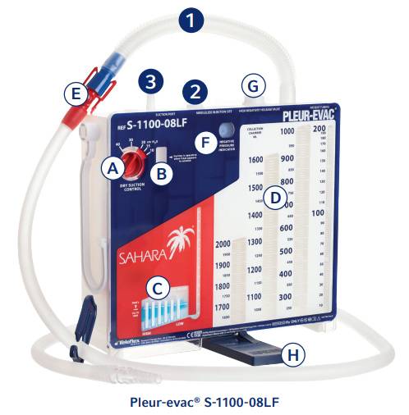
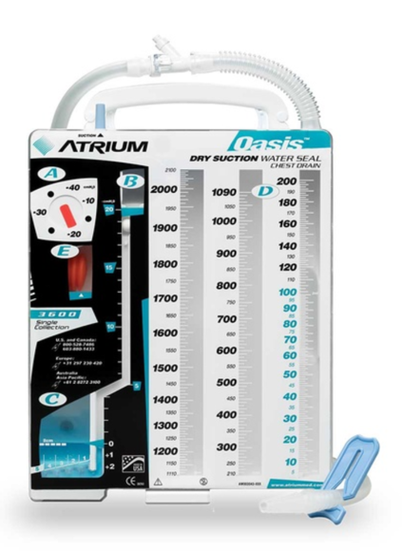
Short Term Substitutes for [Product Name] Supply Chain – Date
First Preferred Sub
[Substitute Product Name]
Lawson#
REF#
Situation: {Example}
• Shortage of Getinge - Atrium Oasis Dry Suction-Water Seal Chest Drain
Background: {Example}
•Getinge experiencing backorder
Assessment: {Example}
•There is a need to substitute with Teleflex Pleur-evac Chest Drain System
Resolution: {Example}
•Short term sub with Teleflex Pleur-evac Chest Drain System
Supply Chain teams will temporarily stock the appropriate [Product Name]
EXAMPLE
Backordered [Product Name]:
[Backordered Product Name]
L#
REF #
EXAMPLE

